Slide 1
JavaScript in modern automation testing
What can we do with browser DOM API ?

Slide 2
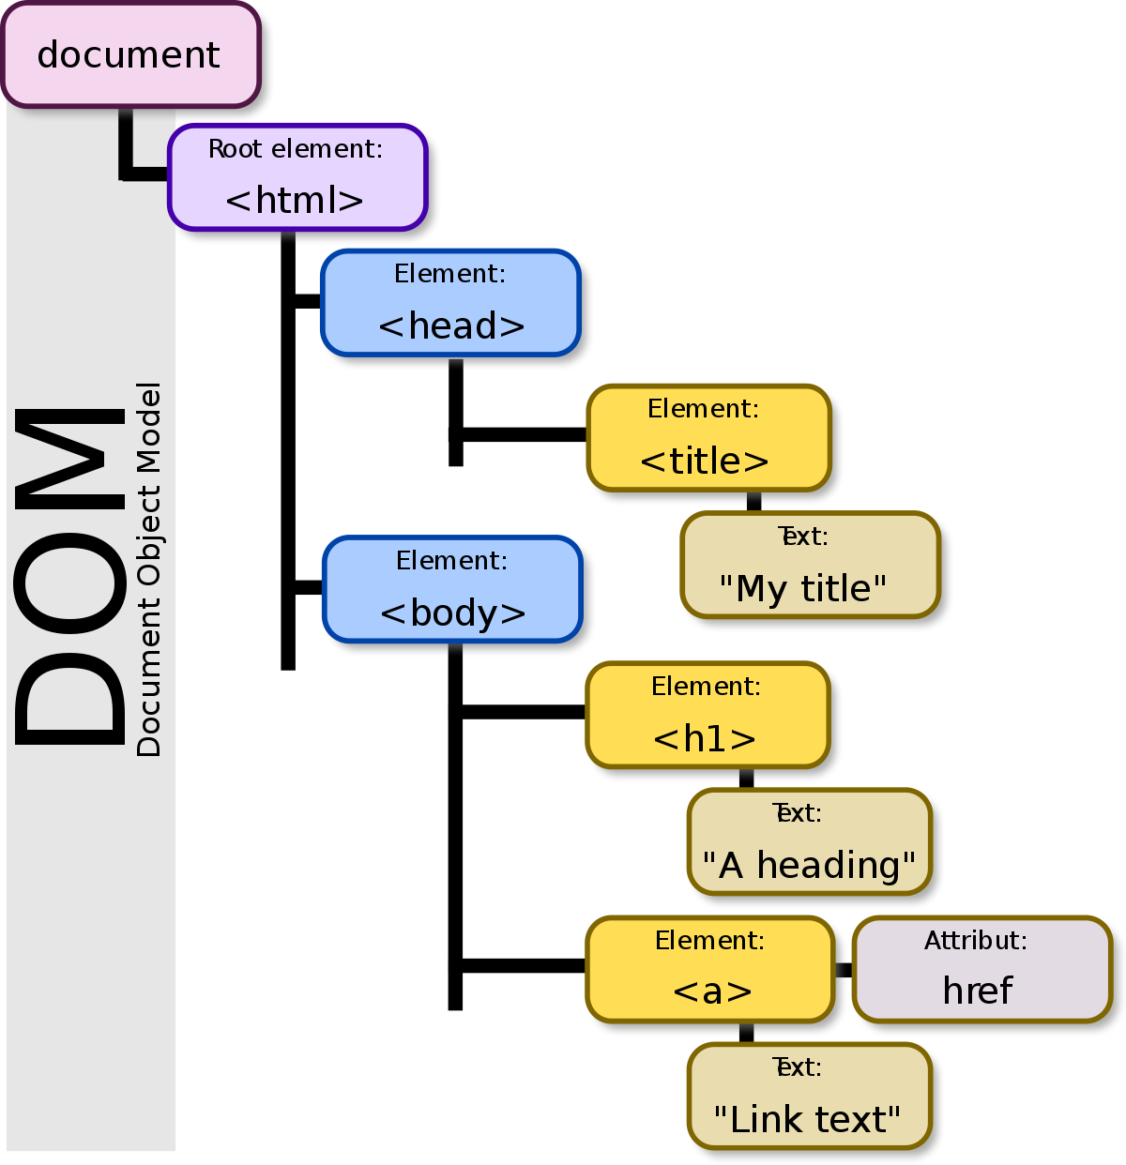
DOM API
DOM rendering
DOM fetch resources
DOM reflow

Slide 3
A reflow computes the layout of the page. A reflow on an element recomputes the dimensions and position of the element, and it also triggers further reflows on that element’s children, ancestors and elements that appear after it in the DOM. Then it calls a final repaint. Reflowing is very expensive, but unfortunately it can be triggered easily.
Reflow occurs when you:
insert, remove or update an element in the DOM
modify content on the page, e.g. the text in an input box
move a DOM element
animate a DOM element
take measurements of an element such as offsetHeight or getComputedStyle
change a CSS style
change the className of an element
add or remove a stylesheet
resize the window

Slide 4
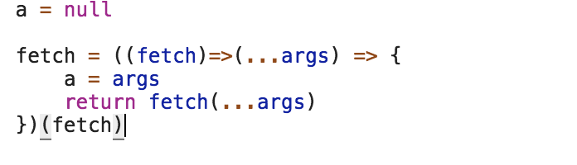
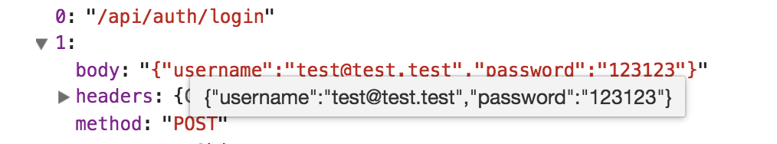
Easy monitoring with JS
fetch

Slide 5
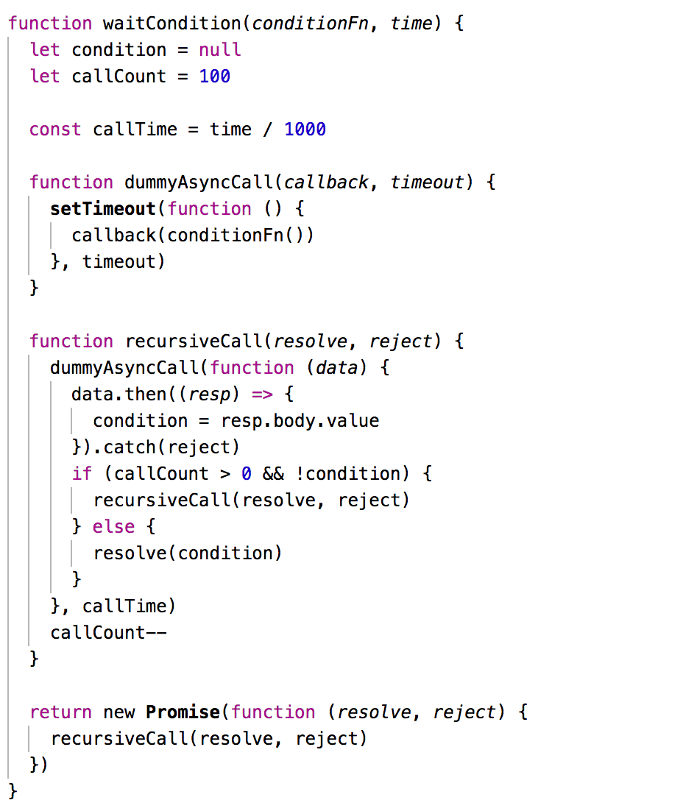
document.readyState
Recursive async call function with wait in every loop

Slide 6
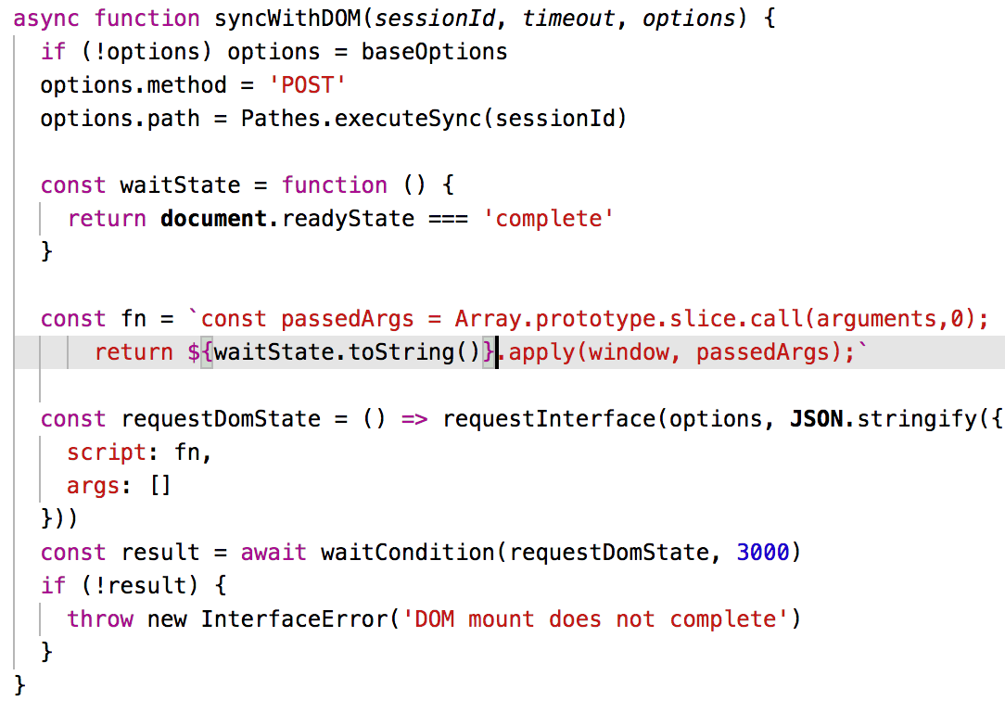
My interface for sync with DOM render complete

Slide 7
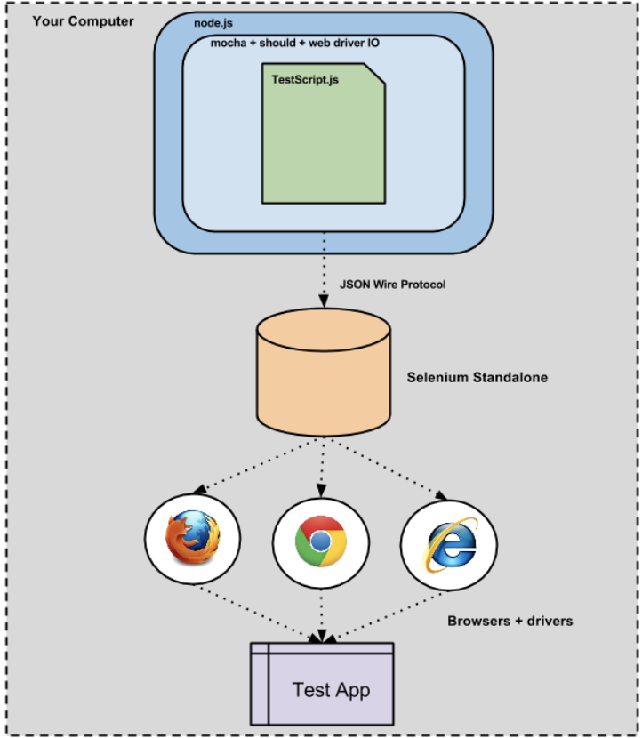

Slide 8
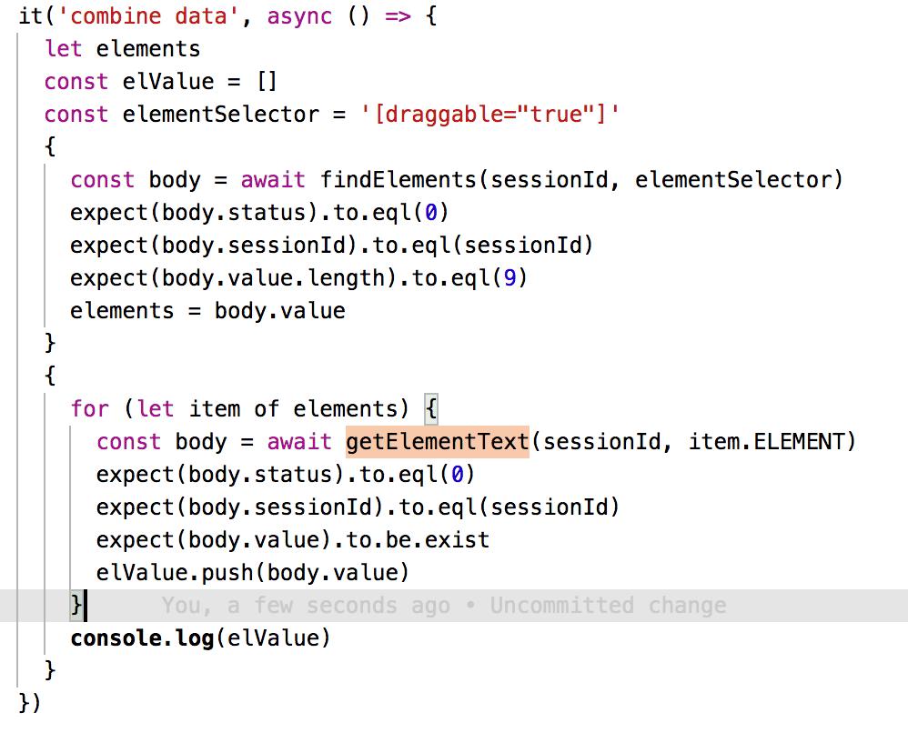
Combine data by request model

Slide 9
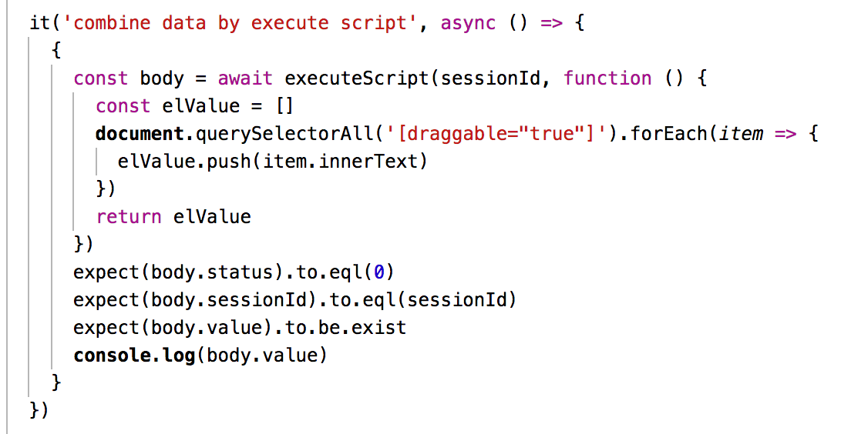
Combine data by execute script on page

Slide 10
